Slide 1

Data Science Simplified
Joaquin Cordero

Slide 2

What is Data Science?
Data Science is the umbrella term for using large amounts of data collected, then finding the correlation between them so that we can make efficient decisions.

Slide 3
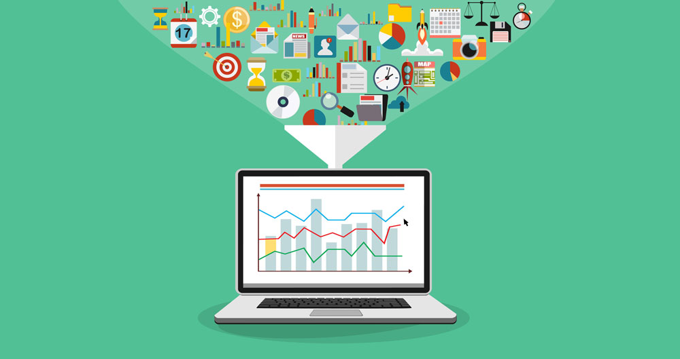
Where do we collect data?
Data is gathered everywhere. To as little as daily routines of individuals and to as big as everything in our entire globe. It all depends on what we want to collect.

Slide 4
When do we collect data?
We collect data when there are questions, we want answered. For example, for employee appreciation what is the best gift to give?

Slide 5
Why do we collect data?
We collect data because the questions we have are not easily answered. We can collect data to find a more accurate and efficient answer.

Slide 6
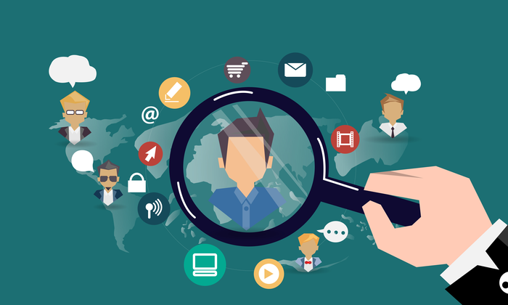
Who do we collect data from?
We collect data from our targeted audience based on the questions we want answered. For example, employee appreciation, we collect data from our employees!

Slide 7
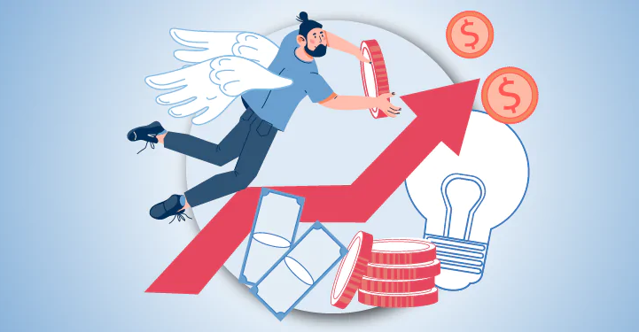
How can we use data science as part of the business?
We can incorporate data science as part of our business to see the bigger picture. Doing so, we are able to be cost efficient with our decisions.

Slide 8
Data driven decisions?
You may wonder why can’t we just make decisions based on previous experiences. Previous experiences is still data driven decisions since we are deciding from outcomes of past events.

Slide 9
Should we have a team of Data Scientist?
Yes, we want to know why we are making these decisions and have solid evidence to support them.

